Slide 1

Five decADES, Shifting emphases

Slide 2
ATEE through fifty years
Fifty years of conference themes
An exploration of conference proceedings
An inventory of publications
And my personal involvement in ATEE for over four decades
Led to the following impression of how the ATEE developed through the decades:

Slide 3
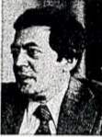
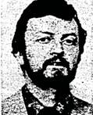

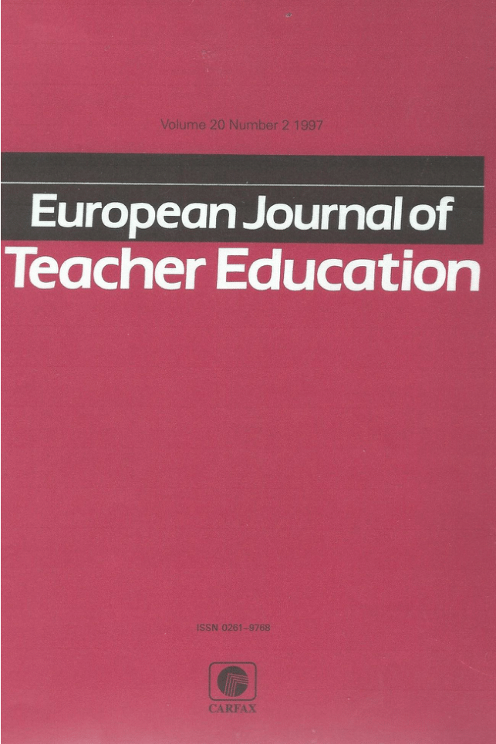
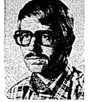
The pioneer phase 1976-1985
Chris Schrijner
ATEE was founded in Liège in 1976, on the initiative of Friedrich Busch and Mario Reguzzoni. Since its creation, membership has expanded noticeably, especially in Central and Eastern Europe as well as in other parts of the world
The first president was Chris Schrijner
At first the aim was to create a community of European teacher educators
ATEE was intended to be a movement
It was multi lingual (French, German and English)
Focussing on getting acquainted, get to know each other’s educational systems and systems of teacher education including in-service teacher education
Initially the Emphasis was on subject based teacher education including vocational education and special needs education
The journal of the Association for Teacher Education in Europe (ATEE) was first published in 1978. At that time, it was known as Revue ATEE Journal (1978–1982)
In 1982 the journal became known as the European Journal of Teacher Education
Rhys Gwyn
Friedrich Busch
Egon Foldberg

Slide 4

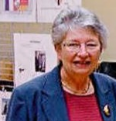
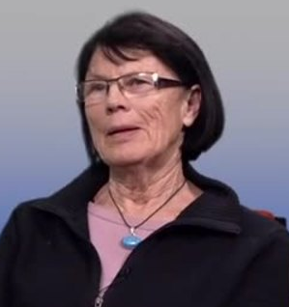
Technology, organisation and professional development (1986-1995)
Jean van Combrugge
In the second decade of its existence the ATEE extended its scope towards training for school management and organisation
The Professional development of teachers in courses as well as in school- based settings gained support
Information technology, although a theme from the start, continued to be an important issue
Equal opportunities, women's emancipation and gender equality were as relevant then, as they are today
In these days some conferences like the ones in Berlin, Toulouse, Barcelona and Lisbon were very well attended.
David Hellawell
Hans Vonk
Francine Vaniscotte
Anne-Lise Høstmark Tarrou

Slide 5
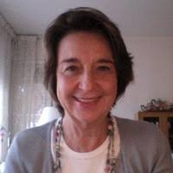
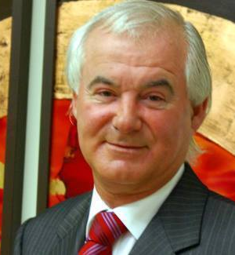

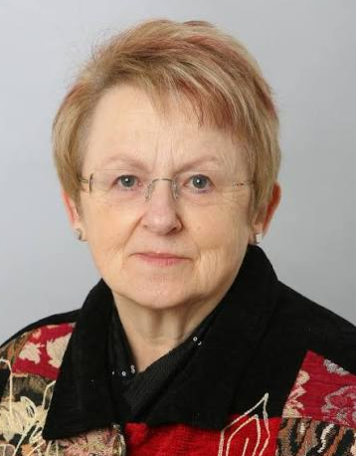
New views on learning and teaching 1995-2006
Mireia Montané
Increased attention is devoted to schools as learning environments
The European Commissions establishes a series of programmes to stimulate education, research and cooperation in Europe with a growing number of EU projects (funded from EU sources such as the Comenius, Erasmus, Lifelong Learning Programme, and Erasmus +Programme) as its effect.
From learning schools, the emphasis shifted towards learning school partnerships and collaboration.
Cross national co-operation increased, involving teacher educators ,teachers, and students of all EU countries, and other eligible countries.
Institutes, colleges and schools learn from and with each other.
Kieran Byrne
Arno Libotton
Maureen Killeavy

Slide 6
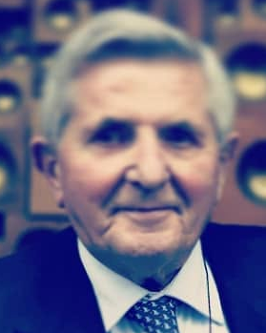
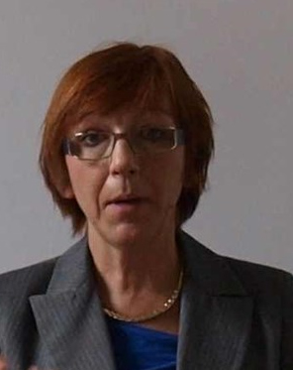
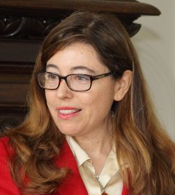
Focus on RESEARCH, societAL ISSUES, AND DILEMMA’S (2006-2015)
Giovanni Polliani
Equity Diversity, and Inclusion are a growing concern in Education
Also, the ATEE promotes the Intercultural dialogue
ICT remains a priority
Lifelong professional development is promoted everywhere
The idealism of the founding fathers, who wished ATEE to be an important player in EU wide educational policy development re-appears in conference themes as “Policies and professionalisation,” and “Educating for the future.”
Teacher educators are increasingly wondering what their role and identity will be in the future
Further attention is paid to ways to make co-operation turn into effective learning communities
Justina Erčulj
Joana Salazar Noguera

Slide 7
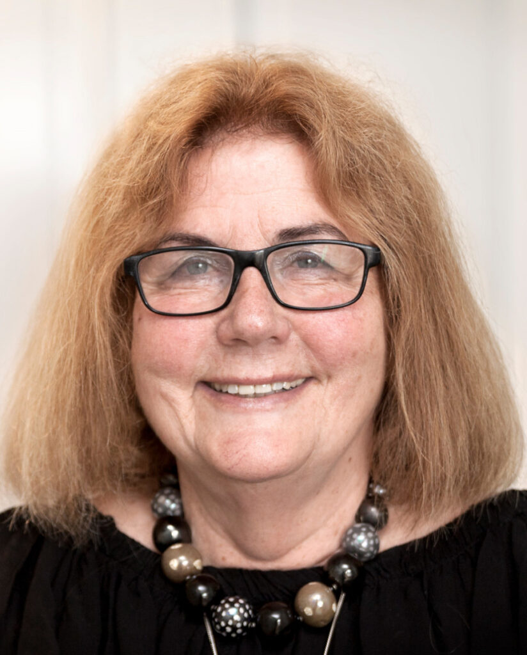
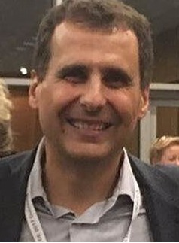


2016- 2025 ongoing professional development in turbulent times
Asa Morberg
The last decade has been the most turbulent one
In conference themes, a need to search for new perspectives in changing contexts becomes visible
Issues of sustainability, climate change, lack of energy resources, water supply problems, raise questions about te role and the responsibility of (teacher)educators.
Europe was confronted with the one of its most important members leaving the Union (BREXIT). This had enormous consequences for the composition of EU projects, now that the UK suddenly was no longer and eligible country for EU funding
The Corona crisis struck the world. In the ATEE this meant that conferences either were cancelled, or held online. The association is still recovering from it. Face to face meetings are no longer self evident
Geopolitical issues have shocked the world. Financial resources are being reserved for defense. Budgets for Education were reduced.
The changing global context urges us to remake and reimagine Teacher education
What is needed is resilience and autheticity to educate responsible, authetic teachers able to inspire students
Davide Parmigiani
Michiell Heijnen
Agnieszka Szplit

Slide 8
An evolution of Fifty Years
From teaching classroom teachers towards educating educators
Incresing attention to professional and school development
From initial teacher training to towards life long learning of teachers
From learning schools, towards learning communities and school partnerships
Growings awareness of multiple roles of teacher educators in schools and in society
From school based teaching and learning towards digital learning environments
Re- imagining and respositioning the teacher’s and teaacher educator’s profession in a complex world
Articulating and preserving the role and authenticity of educating, teaching, and learning
Thus Crossing borders between countries, disciplines, and between the actual and the digital world became the theme of the Bialystok Conference.

Slide 9
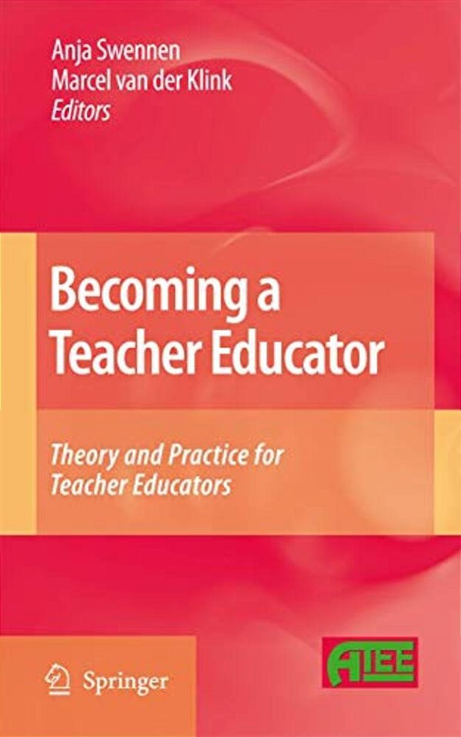
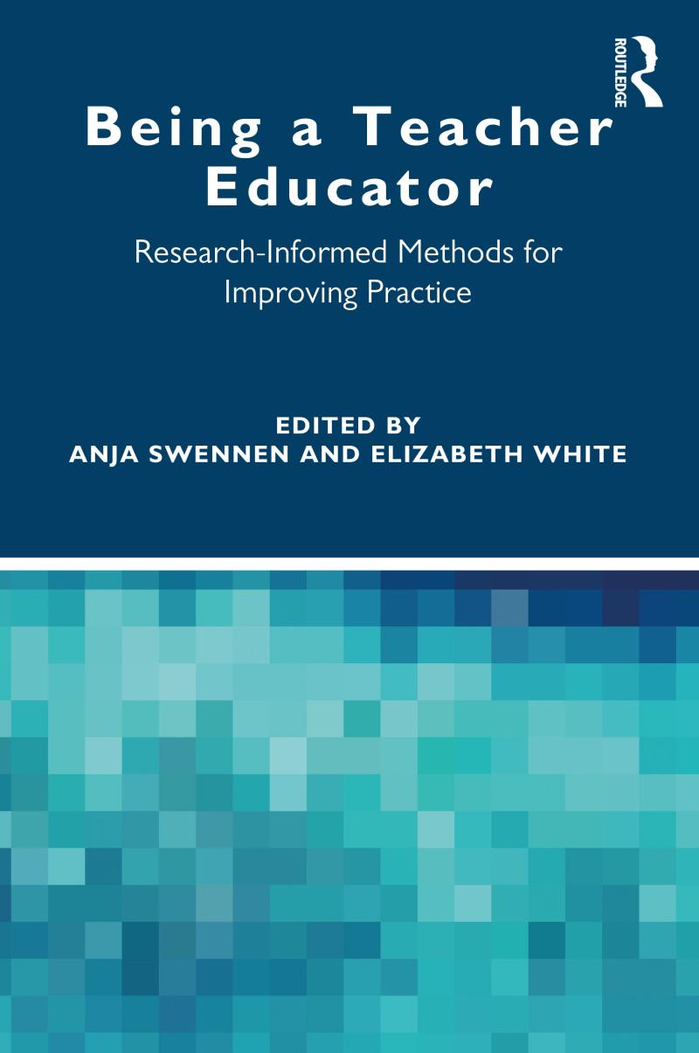
Books published in 2009 and 2020

Slide 10
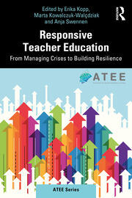

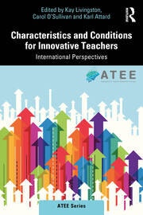
4 Series Titles
Per Page
12 24 48
Sort
Publication Date Title (Asc) Title (Desc)
Include Forthcoming Titles
Display
Responsive Teacher Education: From Managing Crises to Building Resilience
1st Edition
Forthcoming
Edited By Erika Kopp, Marta Kowalczuk-Walędziak, Anja Swennen
August 19, 2026
Teacher education is facing unprecedented challenges: from teacher shortages and shifting policy landscapes, to the rapid expansion of digital learning. This book serves as a continuation of key themes discussed at the 2024 ATEE Annual Conference in Budapest, Teacher Education on the Move, and ...
1st Edition
Edited By Cornelia Connolly, T.J. Ó Ceallaigh
December 18, 2023
Assessment and feedback are central to the question of how teacher educators
can enhance and transform teaching and learning.
This edited volume details case studies and empirical research presenting
alternative innovative designs for assessment and feedback across a range of
programmes, mediums.t Ed
Edited By Kay Livingston, Carol O'Sullivan, Karl Attard
July 31, 2023
Characteristics and Conditions for Innovative Teachers:
International Perspectives is a must-read for all those with an interest in
teacher education and in enabling teacher innovation.
It provides a blend of education theory, practice and research and will appeal
to a wide audience including
1st Edition
RECENT BOOKS

Slide 11
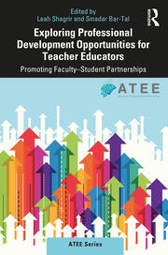
Edited By: Erika Kopp, Marta Kowalczuk-Walędziak, Anja Swennen
August 1 9, 2026
Teacher education is facing unprecedented challenges: from teacher shortages and shifting policy landscapes, to the rapid expansion of digital learning. This book serves as a continuation of key themes discussed at the 2024 ATEE Annual Conference in Budapest,
Teacher Education on the Move.
1st Edition
1st
      Edited By Leah Shagrir, Smadar Bar-Tal
      July 15, 2021
    Focusing on the partnerships and collaborations between teacher educators and students with regards to faculty members’ professional development, contributors from around the world provide insight into professional development opportunities in the context of teaching and collaborating with students.

Slide 12
The ATEE brings to its members:
a World-wide Network of Contacts
Insight in the Evolution of Teacher Education
a Community of Professional Friends
a Platform for Publishing, Reports, Articles and Books
Regular Opportunities to meet and work together during Annual , Winter and Spring Conferences and in Projects, or other Shared Activities
State of the Art knowledge and information about Teacher Education, through Inputs of Key note speakers at ATEE Conferences

