Slide 1
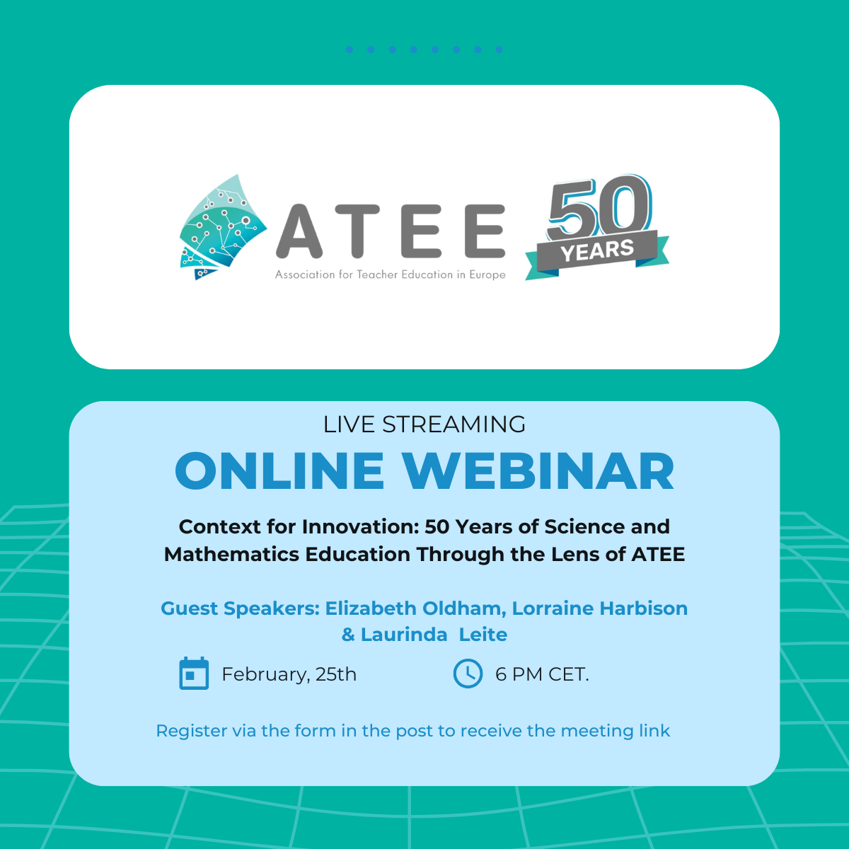

Slide 2

Outline
Part 1 (Slides 3-30): Context for Innovation: Fifty years of science and mathematics education through the lens of ATEE
Elizabeth Oldham
Part 2 (Slides 31-33): Who we are
Lorraine Harbison
Part 3 (Slides 34-42): ATEE Winter Conference 2026
Laurinda Leite
Note: The (approximate) text for the first two parts is in the “Notes” sections of the slides

Slide 3

Context for Innovation: Fifty years of science and mathematics education through the lens of ATEE
Elizabeth Oldham
ATEE@50: 25th February 2026
Notes:
[NOTE: the approximate script for the presentation is included in the notes, with emphasis to aid delivery.]
Thank you, Agnieszka! I am honoured to be invited to present this webinar as part of the Association’s jubilee celebration.

Slide 4





Pronunciation
ATEE E
ATTAY !!!
To any English viewers: apologies; I made the slide a while ago, before Saturday’s very surprising result.
Notes:
First, I should address how we pronounce the initials or acronym for our association! It varies across countries and even within my own country, but perhaps the most familiar form is “Attay” – which has the merit of being short; so I’ll use it.
[The text at the bottom of the slide refers to Ireland unexpectedly beating England in a Rugby international a few days before the webinar.]

Slide 5
Outline
Dates are indicative
1. Introduction: Themes for the talk
3. The early years (1970s-1980s)
4. The middle years (1980s-2000s)
5. The new century: Influence of the international studies
6. The current period (?- ?)
2. Background: “Ah yes, I remember it well”
1 & 2. Setting the scene
3, 4, & 5. The main story
6. Where are we going?
Notes:
The outline for the talk is listed on the slide. The first two sections set the scene; the next three provide the main story; and the last one deals with the present.
I should say that the dates shown are indicative and fuzzy; they differ across countries and indeed across subject areas.

Slide 6


1. Introduction: Themes for the talk
Themes over the years 1976-2026
Curriculum (and / including assessment)
Nature of science and mathematics
Brief:
Examine the profound shifts in science and mathematics education over 50 years
International studies of (curriculum and) attainment
Teaching and learning (T&L)
Notes:
By way of Introduction, I have picked out some themes for the talk. Over the years, many topics have been discussed; but, with an agreed brief that I would examine profound shifts in science and mathematics education over the lifetime of ATEE, I came up with four: the nature of science and mathematics; curriculum and (or including) assessment; teaching and learning; and those pesky international studies of (chiefly) attainment.
Perhaps only one of those – teaching and learning – is very obviously connected with teacher education…

Slide 7
Introduction (cont.)
Themes for teacher education
Implementation / enactment of curriculum (and focus on assessment)
Teacher beliefs about the nature of science and mathematics
A story –
ATEE’s and my story – with themes colour-coded
Teachers’ approaches to T&L
Interpretation of international studies of (curriculum and) attainment
Beliefs about T&L
Notes:
… but I claim they all are highly relevant [for teacher education]. Research has indicated the importance of teachers’ beliefs about the nature of their subjects; teachers are the people who implement or enact curricula, and who deal with much assessment; obviously the approaches to teaching and learning are topics in the ATEE domain, and teacher beliefs are very important here too; and teachers – and others – need to understand the findings (and limitations) of the international studies.
I tried various ways of preparing this talk – by theme; by subject area – but they didn’t work; so in the end I decided to tell a story – ATEE’s story and mine – with the themes colour-coded on the slides as they arise. Like the dates, the coding is fuzzy; but red will indicate that I’m referring mainly to the nature of the subjects, yellow – curriculum, blue – teaching and learning; and (eventually) green for the effect of the international studies.

Slide 8
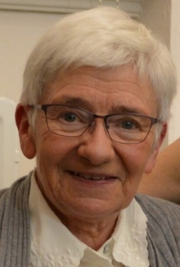
2. Background: “Ah yes, I remember it well”
Elizabeth Oldham
Undergraduate / graduate degrees in Mathematics
Secondary Mathematics teacher (1970!)
M.Ed. thesis on an Irish integrated science curriculum innovation project
Lecturer / researcher in (mainly) Mathematics Education, 1973 - …
Member of ATEE from 1981 (initially Digital Technology group)
Worked with Irish and also international (TIMSS & PISA) curriculum / assessment groups, 1976 - …
Notes:
Since this is partly my story, I included some points about myself. They are listed on the slide, and you can see that mathematics is dominant but there are science aspects too. Details aren’t important; rather, I can focus on the slide title. “Ah yes, I remember it well” is a song from the film Gigi, and the point of the song is that the two singers don’t remember it well; their memories differ, and some must be incorrect. Maybe that’s true for me, but I hope I can substantiate everything from the literature.

Slide 9

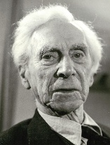
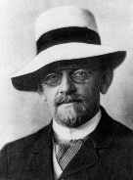
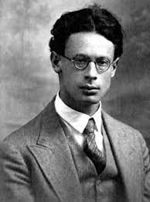
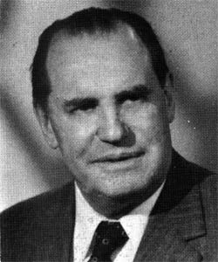
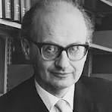
Background (cont.)
My beliefs and experiences (and biases?) over time…
School (and home background): mathematical theorems were true, proved, science had ideas that improved
Undergraduate: mathematics nearest to absolute truth; science theories
Graduate: three phases, profound shifts: from philosophies of mathematics, via (French) Bourbakiste “modern mathematics”, to mathematics being fallible, quasi-experimental (Lakatos)
Lecturer / researcher: ongoing learning – e.g. through ATEE!
Notes:
Given what I said about the importance of beliefs, I should identify mine – also my experiences and maybe my biases!
I was lucky in my schooling – well taught – and also my home background. Bear in mind that I’m talking of the 1950s; thus, mathematical theorems were presented as truth, and were proved – the proofs demonstrated, and we addressed deductions (riders or cuts, however named) in class. For science, it was more a case that ideas improved. Think of theories about light, we heard about the particle theory being replaced by the wave theory – admittedly I think that the latter was presented as true.
I chose mathematics as my undergraduate subject partly because I felt it was as near as we came to absolute truth.
Then I went on to graduate study; and this was where I experienced profound shifts. I took an entirely optional course on the philosophy and foundations of mathematics. It was there that I first heard about the different (unsuccessful) attempts to guarantee mathematical truth. The reaction was the Bourbaki group’s formulation of what became known as “Modern Mathematics” (New Math in the USA). This is key to what follows, and provides a model for much that happened since…
[Resumed after slides 8 and 9]
I really loved the Bourbakiste mathematics in its appropriate context.… But then I attended a couple of occasional lectures by Imre Lakatos, and met the idea that mathematics was fallible and quasi-empirical; rather than guaranteeing truth, we were always guessing and improving our guesses. Wow! So my thinking was shifted: from philosophers of mathematics Russell and Hilbert, via Bourbakistes Andre Weil and Jean Dieudonné, to considering Lakatosian fallibility.
Going on to my lecturing career, maybe there haven’t been such strong shifts in my views of mathematics – but I have gone on learning … not least from my involvement with ATEE.

Slide 10
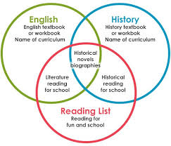
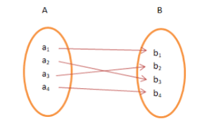
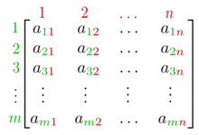
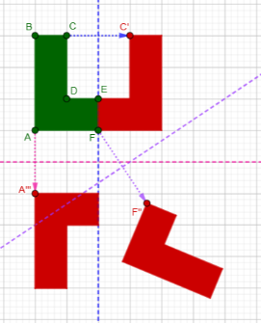
Background (cont.)
Modern Mathematics period – the content
We SET out (with our RELATIONS) on a great adventure
In some countries, algebra was (re)STRUCTURED
Complex numbers, vectors; groups, matrices…
Geometry was “TRANSFORMED” (REFLECT on that!)
AND
“À LA MODE to teach statistics” (there was a greater CHANCE than before of finding probability in school curricula)
“INEQUALITIES [across countries] in the treatment of algebra”
Calculus INTEGRATED into more curricula
f: R → R : x → x²
Structures; abstraction, rigour, proof
Notes:
… but I suspect that for some listeners, it’s unfamiliar ancient history. If so, look at the boxes outlined in black on the right-hand side of the screen. (Those who know about the movement can read through the awful puns on the left-hand side.) The Bourbaki group saw mathematics as the study of structures – based on sets and operations on their elements or relations between them. The Bourbakistes valued abstraction; it’s characterised by abstract algebra, with topics such as matrices and groups (I taught groups in school); and it valued rigour and proof to establish logic within the system.

Slide 11


Background (cont.)
Modern Mathematics period – impact
(Poor) Implementations
Intentions
Emphasise understanding – mathematical coherence
Not meant for junior primary!
Inappropriate / meaningless T&L; teacher knowledge issues
Modernise pre-university mathematics
Endorsed by Piaget
Static vision of mathematics
Notes:
For school mathematics, Modern Mathematics was intended to modernise pre-university mathematics (so, coded yellow for curriculum); there was a focus on learning with understanding – understanding in terms of mathematical coherence, making logical sense. And its nature was endorsed by Piaget, no less.
But what happened in practice? I’ll start on the right; it was never meant to affect junior primary curricula, but it did. Even at higher levels, there was a teacher knowledge issue; if teachers didn’t know what it was meant to be about, then they tended to teach it as meaningless rules and symbol manipulation rather than identifying the grand patterns and golden threads. Anyway, not everyone endorsed the static, “pure,” Bourbakiste conception of mathematics. So it is widely classified as a failure.

Slide 12
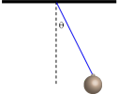
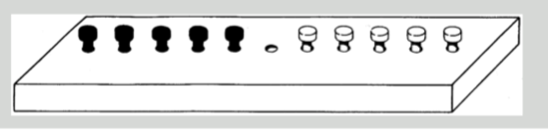

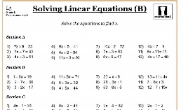
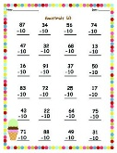
3. The early years (1970s-1980s)
The mathematics story
Pendulum swings away from Modern Mathematics
… though some new content remained
Nature::Product (truth / arbitrary rules) or process (… or both)?
Back to the basics (e.g. USA): behavio(u)rist drill & practice
Investigations (e.g. England & Wales): activity; acting like mathematicians
https://math.stackexchange.com/
Notes:
So let’s think about what was happening in mathematics education around the time that ATEE was founded. The pendulum was swinging away from modern mathematics, which hadn’t worked as intended. A prominent debate was about whether mathematics was a product – wonderfully and eternally true, or perhaps a collection of arbitrary rules that were found in school textbooks – or whether it was a process: something that mathematicians did.
Regarding product, in the USA there was a strong move “back to the basics”, focusing on things not well learnt in the “modern” period: drill-and-practice approaches informed by behaviourism. By contrast, some people in England and Wales focused on process: students doing investigations, acting like mathematicians. The pictures show an archetypal one where the challenge is to exchange the two sets of pegs (or frogs, in some versions) according to certain rules … and to do it for different numbers of pegs, eventually making a conjecture and perhaps proving a general rule for the number of moves needed.

Slide 13
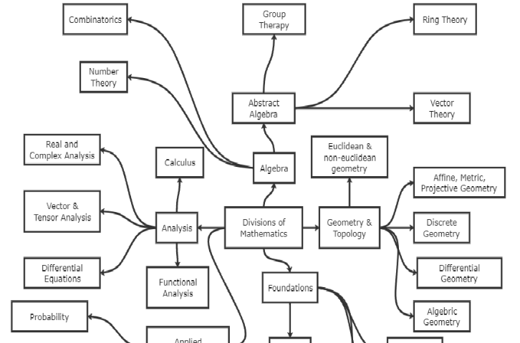


The early years (1970s-1980s) (cont.)
The mathematics story (cont.)
Mathematics as a process / activity
Understanding (Skemp, 1976 [and 1977]):
relational versus instrumental
Thinking mathematically (Stacey, Burton, & Mason, 1982): “The gentle art of mathematicking”
Implications for curriculum / assessment (Cockcroft, 1982)
Notes:
From the early 1980s, I pick out three seminal publications. In terms of process and activity, a highlight was a 1982 book on “thinking mathematically” … expressed by the third author – John Mason – in an article I now can’t find, indulging in “the gentle art of mathematicking.”
Alongside this came insights on learning mathematics. Richard Skemp’s seminal paper – published in England in 1976 (the year of ATEE’s birth) and republished in the USA the following year – distinguished two forms of understanding (relational and instrumental): understanding why – seeing the connections and relationships – and understanding how, knowing what to do but in isolation. And regarding curriculum and assessment, a key publication was the 1982 Cockcroft Report, addressing England & Wales but influential much more widely in the middle of the 1980s. [And even now – it hasn’t gone away, you know….]
References:
Cockcroft, W. H. (1982). Mathematics counts: Report of the Committee of Inquiry into the Teaching of Mathematics in Schools. Her Majesty's Stationery Office (HMSO).
Skemp, R. R. (1976). Relational understanding and instrumental understanding. Mathematics Teaching, 77(1), 20-26.
Stacey, K., Burton, L., & Mason, J. (1982). Thinking mathematically. Addison-Wesley.
The image is from: Wehry, S., & Goudy, L. (2006). Concept mapping in middle school mathematics. In A. J. Cañas & J. D. Novak (Eds.), Proceedings of the Second Conference on Concept Mapping. San José, Costa Rica (pp. 66-69).

Slide 14
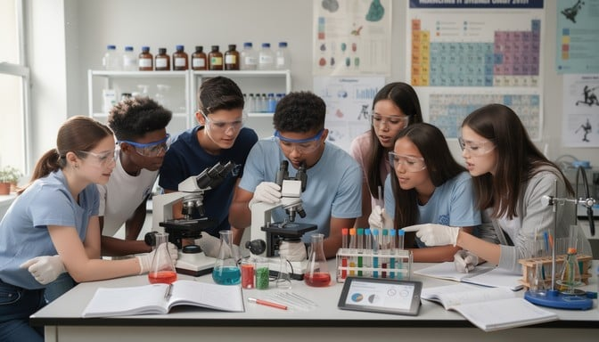
The early years (1970s-1980s) (cont.)
The science story
From 1960s, Nuffield Science
A project to improve science teaching in English & Welsh secondary schools, using a discovery learning approach
Hence, intended to reflect science knowledge as truth emerging from the scientific method
Not a curriculum as such, though had alternative national examinations
As implemented, tended to underemphasise content…
Ongoing influence
Thanks to Laurinda Leite for “science” help
Notes:
Turning to the science story, I have to backtrack a bit to set the scene. In the 1960s, there was a groundbreaking science education project – Nuffield Science – that promoted a discovery learning approach. Via use of “the” scientific method, students would discover scientific “truths”. It didn’t prescribe a curriculum (the aim was to improve teaching), bit it was accorded alternative national examinations.
A criticism of what happened in practice was that teaching tended to underemphasise content.
It – Nuffield Science – continued to be influential…

Slide 15
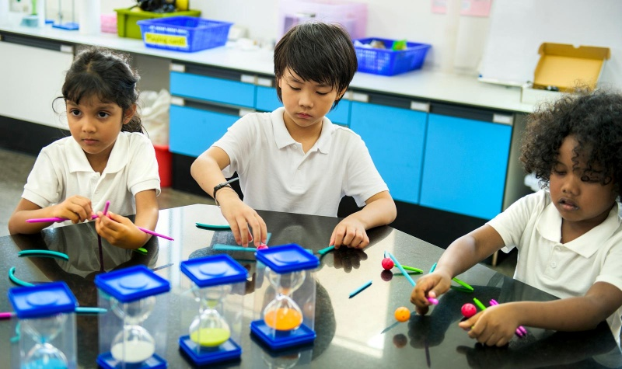
The early years (1970s-1980s) (cont.)
The science story (cont.)
1970s: “integrated science projects”
Example: WISCIP, West Indies Science Curriculum Innovation Project
My experience: ISCIP, Integrated [or Irish] Science Curriculum Innovation Project
Intention: Scientific method, discovery learning; in practice: the students enjoyed rushing around in groups….
Alternative national examinations – a breakthrough in Ireland
Notes:
… and other projects were developed. There was WISCIP, the West Indies Science Curriculum Innovation Project; one of the people involved came back to my university in Ireland and masterminded the Integrated (or Irish) Science Curriculum Innovation Project, ISCIP. My MEd thesis was on the evaluation of the project. Like Nuffield, the focus was meant to be on the scientific method / discovery learning; in practice, perhaps, what came through to the students was enjoyment of rushing around in groups. However, we did achieve alternative national examinations – a landmark development in Ireland.

Slide 16
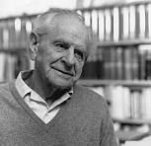
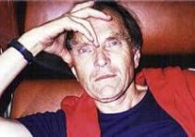
The early years (1970s-1980s) (cont.)
The science story (cont.)
Pendulum swings
From discovery learning to Popperian falsifiability (cf. Lakatos for mathematics)
From “the” scientific method to Feyerabend “Against method”
From science in isolation to science in social context (e.g. SISCON) and science and technology in society (e.g. SATIS)
Again, as implemented / in practice, content not learnt …
Notes:
Proceeding through the seventies and into the eighties, the pendulum swung. Rather than discovering “truth”, there was a focus on Popperian falsifiability; compare with fallibility in mathematics, and indeed Popper and Lakatos interacted. Rather than “the” scientific method, there was a recognition of different approaches in science.
Moreover, the importance of context emerged, with various projects addressing science (and maybe technology) in relation to social and societal aspects.
Overall, however, again the content knowledge didn’t seem to be well attained.

Slide 17
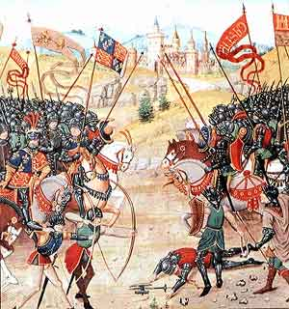
4. The middle years (1980s-2000s)
The mathematics story
Mathematics as process
Authentic assessment (e.g. not just multiple choice)
From the USA National Council of Teachers of Mathematics (NCTM)
1980s to be the “decade of problem solving”
Curriculum and Evaluation “Standards”, 1989 – group work, discussion, argumentation…
Progressive “reform” approaches vs. traditional “tell and drill” – the “Math Wars”!
Standards: banners to follow (inspiring) or levels to reach (accountable)?
Notes:
Moving on from the early years to the middle period, I resume the mathematics story. In the USA, there was a profound shift or pendulum swing away from the rather impoverished back-to-the-basics approach. The influential National Council of Teachers of Mathematics bookended the 1980s with two publications that focused on problem solving as the essence of mathematics. Their “Curriculum and Evaluation Standards” took over from the Cockcroft Report as the reference point: it pointed to teaching and learning via group work, discussion, argumentation – progressive of so-called “reform” approaches, rather than traditional “tell and drill”. There were many people who, so to speak, loved it not; the outcome was the acrimonious Math Wars.
Note the word “standards”: a standard can be a banner to follow (inspirational) or a level to reach (accountable). The NCTM intended both, but perhaps emphasising the inspiration. I do like the picture because it shows banners.
Also in the USA there was a focus on authentic assessment – for example, dealing with real-world problems and not using multichoice tests.
Reference of interest:
Hekimoglu, S., & Sloan, M. (2005). A compendium of views on the NCTM Standards. The Mathematics Educator, 15(1). https://doi.org/10.63301/tme.v15i1.1886

Slide 18
The middle years (1980s-2000s) (cont.)
The mathematics story (cont.)
Typical curriculum phases – USA and Finland
“Reform”
Profound shifts!
Note:
According to Howson (1991), many European curricula in the 1980s were more eclectic (rather than having a dominating philosophy)
But then….
(Lampiselkä et al., 2007)
Notes:
The profound shifts in some countries’ curricula are shown in the diagram, from a Finnish source, and showing the timeline for Modern Maths (New Math in the States), Back-to-the-Basics, Problem solving, and Reform approaches, with the moves in Finland somewhat delayed compared to those in the USA. However, it’s worth noting that (according to Howson (1991)) many European curricula in the 1980s were more eclectic rather than being dominated by any one philosophy.
References:
Howson, G. (1991). National curricula in mathematics. The Mathematical Association.
Lampiselkä, J., Ahtee, M., Pehkonen, E., Meri, M., & Eloranta, V. (2007). Mathematics and science in Finnish comprehensive school. In E. Pehkonen, M. Ahtee, & J. Lavonen (Eds.), How Finns learn mathematics and science (pp. 35–48). Sense Publishers.

Slide 19
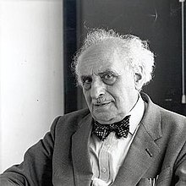
The middle years (1980s-2000s) (cont.)
The mathematics story (cont.)
Realistic Mathematics Education (RME), 1990s
From the Netherlands (Freudenthal Institute)
Mathematics as a human activity
It should be “real to the students” (not necessarily “real-life”)
For learning, problems should be set in engaging contexts (and should not be just routine exercises)
Compatible with constructivist learning
Notes:
But then the 1990s saw the dominance of Realistic Mathematics Education. The brainchild of Hans Freudenthal, a German working in the Netherlands, it had been around there for some time. Freudenthal saw mathematics as a human activity; the work was to be “real to the students” – not necessarily “real-world” – and dealt with solving problems set in engaging contexts, not just routine exercises. RME is a philosophy rather than a learning theory, but it is very compatible with constructivism.

Slide 20
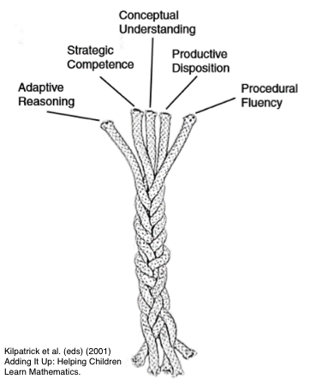
The middle years (1980s-2000s) (cont.)
The mathematics story (cont.)
A teaching conundrum
Conceptual and procedural knowledge (Hiebert, 1986)
Cf. relational vs. instrumental understanding (Skemp. 1976)
Much debate: which should be prioritised??)
NRC (2001) “strands of proficiency” highlights intertwined / interdependent nature
Constructivism / social constructivism
Notes:
Alongside these curricular developments, there was a conundrum regarding teaching and learning. A book by Hiebert, Conceptual and procedural knowledge: the case of mathematics, was about the nature of mathematical knowledge, but closely paralleled Skemp’s work on relational and instrumental understanding. The challenge was: which aspect should be prioritised and indeed taught first – the meaningful concepts, or the more routine busy-work computations? A major publication from just after the middle years gave us the model of intertwined strands, emphasising their interdependence.
As regards learning, constructivism and social constructivism were prominent throughout the decade.
Reference:
Hiebert, J. (Ed.). (1986). Conceptual and procedural knowledge: The case of mathematics. Lawrence Erlbaum Associates, Inc.
National Research Council. (2001). Adding it up: Helping children learn mathematics. J Kilpatrick, J. Swafford, and B. Findell (Eds.). Mathematics Learning Study Committee, Center for Education, Division of Behavioral and Social Sciences and Education. National Academy Press. https://doi.org/10.17226/9822 [PDF is free – see p. 5.]
Skemp, R. R. (1976). Relational understanding and instrumental understanding. Mathematics Teaching, 77(1), 20-26.

Slide 21
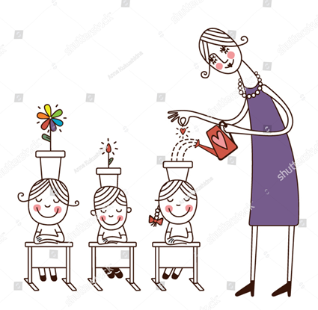
The middle years (1980s-2000s) (cont.)
The science story
Alternative conceptions movement
Children are not empty vessels that need to be filled; they bring their own developed ideas to school ….
Necessitates social constructivist-based approaches such as teaching for conceptual change
See the ATEE story!
Notes:
As so for the science story. There was a pendulum swing towards recognising learners’ alternative conceptions: the thoughtfully formulated, albeit non-standard, ideas that they bring with them into school science, and that are hard to alter. They can be addressed by social constructivist approaches such as teaching for conceptual change…
… and at this point, at last you might say, I bring ATEE back into the story!

Slide 22



The middle years (1980s-2000s) (cont.)
The ATEE story
1980s: emergence of “Working Group” The Training of Science Teachers
Led by Fred Brinkman
later, Onno de Jong
Many interests
Focus notably on “Teacher thinking and conceptual change”
The group’s first project
1990s, joined by mathematics educators
Led by Sarah (Sally) Berenson, they started the “Lesson preparation method” on preservice teachers’ use of concepts / procedures
Name changed
The Training of Science and Mathematics Teachers; later, Science and Mathematics Education
Construct-ivist
Notes:
The group that was then called “The training of science teachers” emerged in the late 1980s, initially led by Fred Brinkman and then by Onno de Jong – both Dutchmen, and indeed the Dutch contributed a great deal to a large and vibrant group. Among mang many interests, teacher thinking and conceptual change loomed large and indeed was the theme of the group’s first project.
In the mid-1990s, the group was infiltrated by a number of mathematics educators (including myself). Led by Sally Berenson, we started a project (the lesson preparation method) that investigated beginning preservice teachers’ use of concepts and/or procedures in envisaging how to teach a topic; and the scientists used it too.
The name of the group changed, first to acknowledge the mathematical presence, and then to a less training-focused “Science and mathematics education.” Many of the participants tended to favour constructivist approaches, but there was room for other ideas.

Slide 23

5. The new century: Influence of the international studies
Prominent trends in education
My biases show
Accountability!
Measurable outcomes!
ATEE maintains balance!
Yes, (some?) discussion of these trends…
… but also e.g. Gert Biesta’s keynote (Warsaw, 2021)
Teacher agency
Measure what we value, don’t value only what we measure
Performativity!
Notes:
This brings us to the new century: a time of accountability, performativity, measurable outcomes, rank-ordering of countries’ achievement scores (the horse-race approach) – my tone of voice indicates my biases! But I do believe ATEE has maintained a balance. We have discussed these trends, but we have also focused on more human characteristics: consider Gert Biesta’s keynote in Warsaw : think of teacher agency and of measuring what we value rather than valuing only what we can measure.
Note:
Gert Biesta’s keynote address was not published in the Proceedings – a dedicated journal issue rather that ATEE’s usual production – so no reference can be provided here.

Slide 24
The new century: Influence of the inter-national studies (cont.)
International large-scale studies (ILSAs)
From 1960s (mathematics) and 1970s (science); occasional, not always influential
From 2000, regular; aimed at informing / affecting policy
TIMSS (Trends in International Mathematics and Science Study)
Curriculum based: tests designed to test common curricular material
PISA (Programme for International Student Assessment)
Ideologically based: RME and SATIS / STS; preparation for (economic) life
TEDS-M (Teacher Education and Development Study – Mathematics
- Teacher preparation – interesting but small numbers involved
Notes:
I typified the period by the large-scale assessment studies: ILSAs to their friends. They were not new in this century – for mathematics they date from the 1960s and for science from the 1970s – but they were intermittent and not always influential. From 2000, they have become more regular and have dominated many discussions. They focus on policy. The two main studies TIMSS and PISA, can be contrasted; TIMSS is based on testing reasonably common curricular material, so perhaps is as near ideologically neutral as one gets, whereas PISA is agenda driven, reflecting the current philosophies of mathematics and science education in preparing students for life … economic life; after all, it comes from the OECD. The first round of PISA took place in 2000.
There are other studies such as TEDS-M, on mathematics teacher preparation – very relevant to ATEE (there was a keynote in Bergamo) but involving few countries.

Slide 25

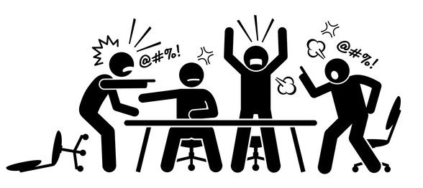
The new century: Influence of the international studies (cont.)
ILSAs reflect – or drive – prominent trends in education
Problematic!!
Controversial!
Normative?
But the studies
do have strengths and uses….
Notes:
Is it that ILSAs reflect trends in education, or do they drive them? Perhaps both! But, in any case, they are controversial, highly problematic – and at least in practice, they tend to be normative, which is why I picked them out for this period. Yes, I can be critical of them: but I have actually been involved with them fairly continuously since 1976 – ATEE’s birth year – and do see them as having strengths and uses.

Slide 26
The new century: Influence of the international studies (cont.)
Example
The three-level curriculum (1980)
Intended
Prescribed typically at country level, with general aims, perhaps teaching approaches
Implemented (or enacted)
What is taught in class
Attained (or achieved)
What is learnt by students
These differ!
Notes:
One such strength or contribution is the concept of the three-level curriculum – actually from 1980, but still fundamental: the intended, implemented and attained curriculum, highlighting that the three levels differ. I have been using the concept throughout this talk, and I really don’t know how one can address curricular and attainment issues without disentangling whether one is addressed national (or equivalent) intentions, or what happens in classrooms, or what children do and don’t learn.

Slide 27

The new century: Influence of the international studies (cont.)
In the context of that framework
I see repeated attempts to improve implementation and attainment of similar goals
Have I been around too long, or is it Groundhog Day?
(Good) Intentions
(Imperfect) implementation
(Imperfect) attainment
Try again
Fail again, fail better??
No profound shifts???
Notes:
So it is in the context of that framework that I postulate: Maybe since 2000 there haven’t been profound shifts in science and mathematics education; rather, there have been repeated attempts to improve implementation and attainment of similar goals. Is it just that I have run out of scope for recognising innovation, or is there really a strong element of “Groundhog Day”? Incidentally, in the cycle, the Samuel Beckett quote about failing better is usually taken to mean having another go and improving – but apparently he actually meant in in terms of getting worse. Let’s settle for the usual interpretation!

Slide 28
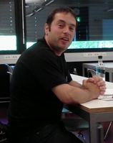


The new century: Influence of the inter-national studies (cont.)
The Science and Mathematics Education RDC story
Projects and papers address varied topics
Projects – continuing themes
The Ratio and Function projects: teacher knowledge / understanding; applications
Mathscify [Lorraine will address]: problem solving, assessment issues
Projects – newer developments
Mathscify: playful approaches
Science teaching: humour, workshop activities (Milan Stojkovic)
Wellbeing (Elsa Price)
Role of STEM / technology?
Notes:
So what about our Science and Mathematics Education RDC story as seen in this light? We have had many and varied papers and a variety of projects, with the latter successful when they were continuing and enhancing previous themes: projects addressing teacher knowledge and understanding, with conceptual and procedural focus as well as applications; and our current one, Mathscify, based on problem solving – Lorraine will address it.
Of course there have been new ideas: Mathscify looks for playful problems; our former Science chair Milan Stojkovic has highlighted humour and enjoyable activities; and our long-standing vice-chair Elsa Price has talked about wellness. We have tried to grapple with the interface with STEM – not very successfully…

Slide 29


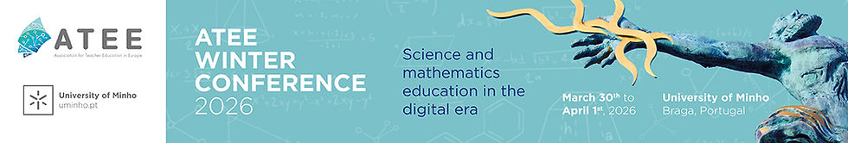
6. The current period (?- ?)
Affordances and challenges
The digital era…
A profound shift!
GenAI
Notes:
… and perhaps that leads me to what surely is the elephant in the room, the area that I could have made one of my themes for this talk: digital technology (where my ATEE adventure started) and now GenAI. This, surely, necessitates a profound shift in much of what we do. There should be some great ideas at our forthcoming Winter Conference in Braga. Perhaps we can meet there in person!

Slide 30

Go raibh maith agaibh Thank you
Notes:
Go raibh maith agaibh – thanks to you all!

Slide 31


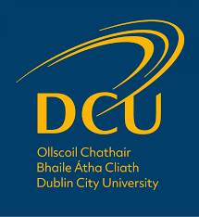
Who We Are
https://atee.education/rd-communities/science-and-mathematics/
Notes:
Who We Are: The Science & Mathematics Education RDC
The Science and Mathematics Education RDC brings together colleagues interested in the enrichment of science and mathematics education across Europe and beyond. We provide a space for discussion, professional learning, and collaborative research.
Over more than three decades, the RDC has developed influential projects and reported work on topics such as pedagogical content knowledge, critical thinking, mathematical identity, and formative assessment. Our members work individually, in small groups, and collaboratively across institutions and countries, nurturing a vibrant and international research culture.

Slide 32
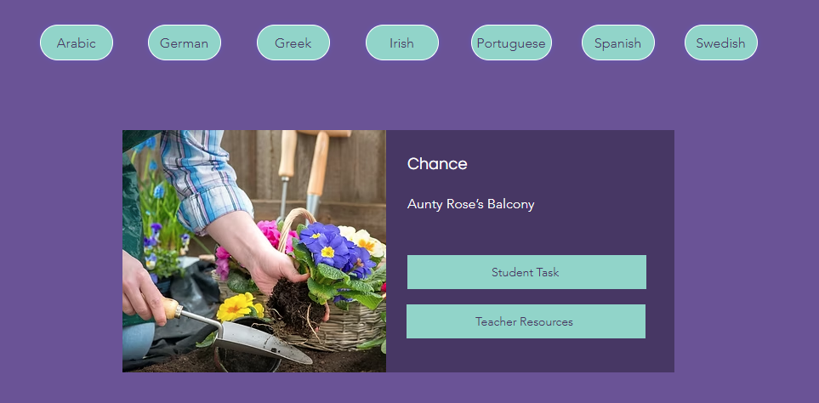
Our Current RDC Project – Mathscify
Ongoing RDC project: assessment toolkit website
Multilingual repository of mathematics / science problem-solving tasks, with teacher resources to support formative assessment
Chiefly mathematics so far
https://www.mathscify.org/
Notes:
Our Current Focus: Formative Assessment & Multilingual Pedagogies.
Our flagship project, Mathscify, grew from shared RDC work on designing low‑threshold, high‑ceiling tasks. The toolkit offers tasks, rubrics, and multilingual supports for formative assessment, aligning with major curriculum reforms and international frameworks such as TIMSS cognitive domains and TRU dimensions of powerful learning environments.
Findings from Irish‑medium immersion contexts highlight the complexities of language and mathematical sense‑making, reinforcing the value of CLIL‑based materials and multimodal task design.
Mathscify now includes tasks in Irish, French, German, Dutch, Portuguese, Arabic, and Spanish, with more in development.

Slide 33
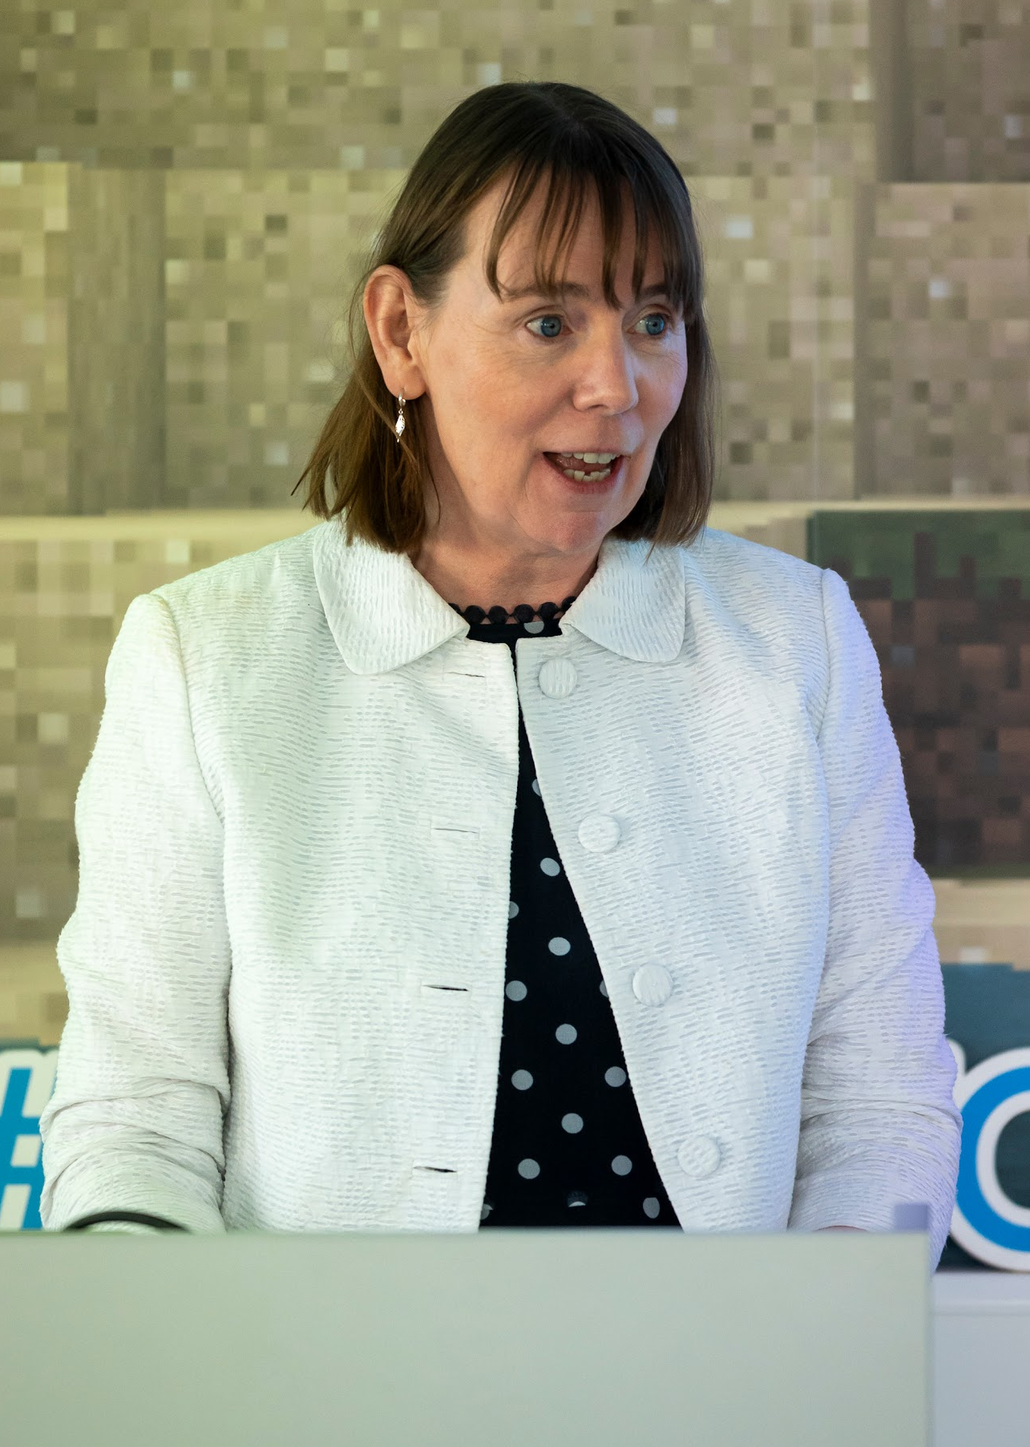


Get Involved
Find out more at www.mathscify.org
Or our dedicated project website rdcsciencemathematics.weebly.com
lorraine.harbison@dcu.ie
Notes:
The RDC’s work responds to international challenges: teachers often struggle to assess non‑routine problem‑solving, to integrate playful pedagogies, or to teach through an additional language. Our projects and areas of interest—such as Mathscify, CLIL, studies on ratio, teacher thinking, and now lesson study (Focus is on (to date) primary teachers’ professional development across different curricular and language settings)—provide practical tools and research evidence to address these needs.
We invite new members to join us: to co‑create tasks, analyse classroom data, contribute to publications, or take part in comparative research across diverse educational systems. You can email me at the address provided on the slide. You can also find out more at www.mathscify.org or our dedicated project website rdcsciencemathematics.weebly.com All colleagues interested in teacher education, curriculum reform, or classroom assessment are welcome.

Slide 34

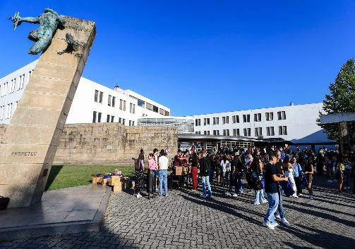
ATEE Winter Conference 2026 March, 30th – April1st
Laurinda Leite
https://www.atee-winter-2026.com/
Laurinda Leite

Slide 35
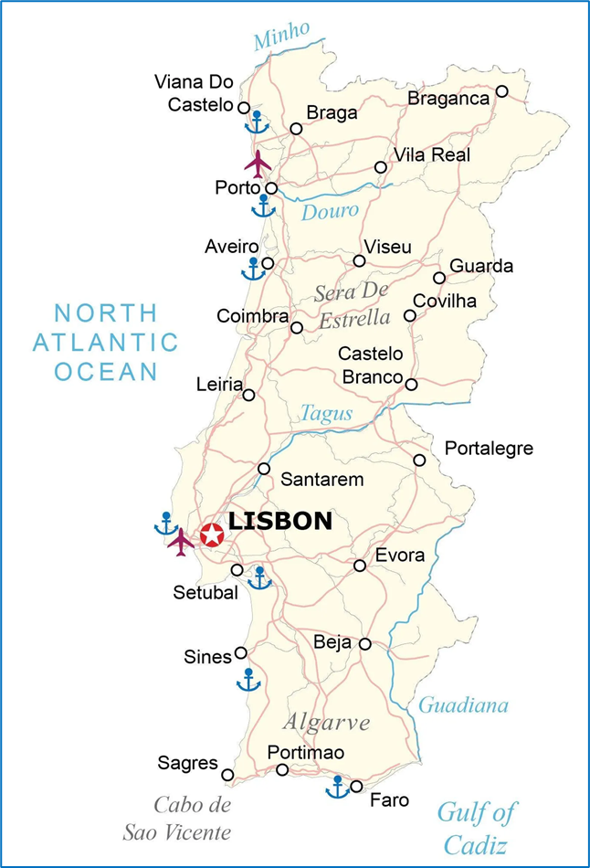
Univ. Minho
Braga
Oporto Airport
OR
Francisco Sá Carneiro Airport

Slide 36
Conference Theme
Science and mathematics education in the digital era
Numeracy
Gamification
Curriculum materials
Scientific literacy
Teacher Education
Maker education
Motivation
Assessment
Artificial Inteligence
Inclusion
Digital Labs
Engagement
Robotics
Digitalisation

Slide 37
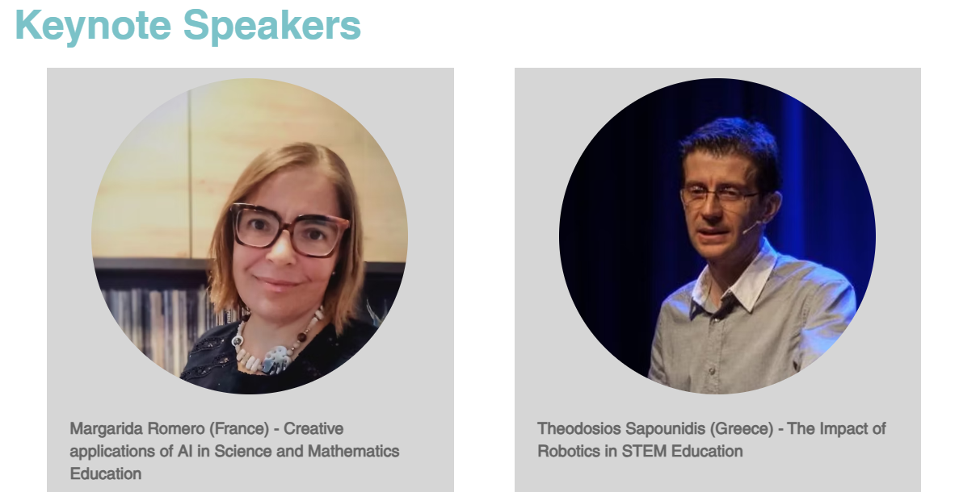
Academic Programme

Slide 38
Academic Programme
Panel: The challenges of science and mathematics education
in the digital era
Moderator:
Lorraine Harbison, Dublin City University, Ireland
Participants:
Paula Korsnakova, International Association for the Evaluation of Educational Achievement, The Netherlands
Lucy Avraamidou, University of Groningen, The Netherlands
Ana Paula Canavarro, University of Évora, Portugal
Maria Assunção Flores, University of Minho, Portugal
Papers and posters (about one hundred)

Slide 39
Social Programme
Visits
Secondary School Carlos Amarante
Iberian Nanotechnology Laboratory (INL)
Free of charge
Welcome Reception
Free of charge
Social Dinner
Extra fee

Slide 40
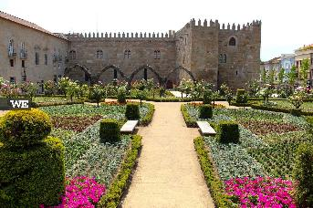
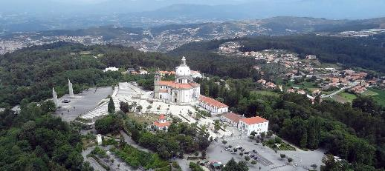
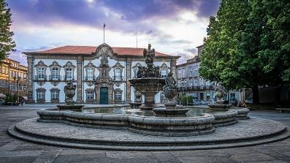

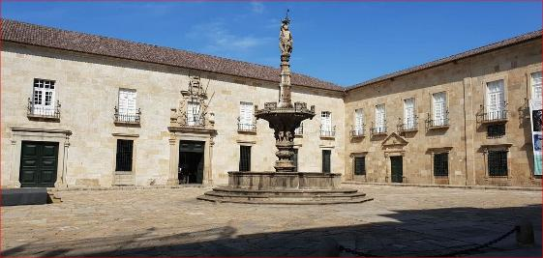
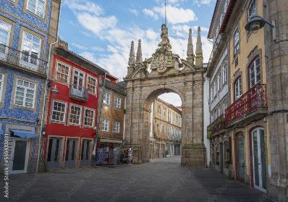
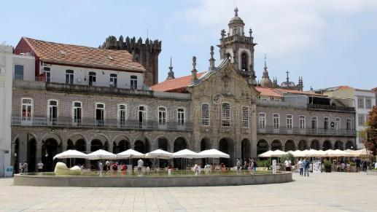
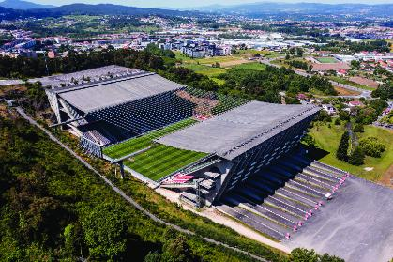
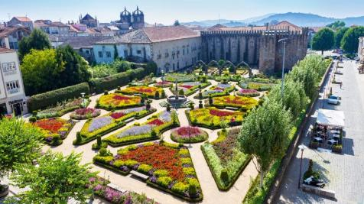
A flavour of Braga

Slide 41
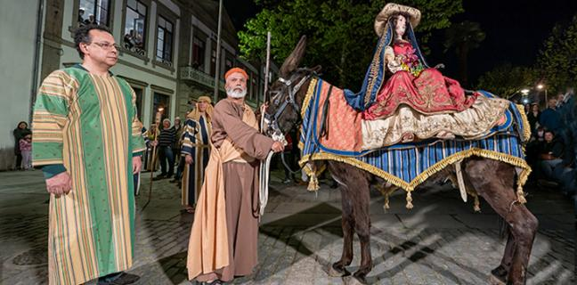

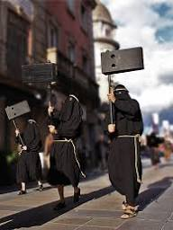
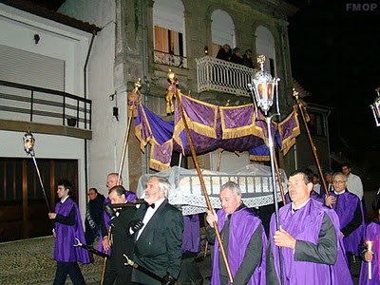

The Holy Week in Braga
A week full of street events!

Slide 42
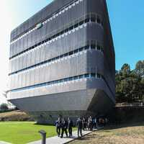
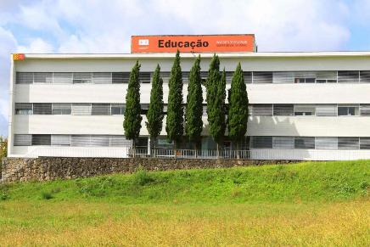
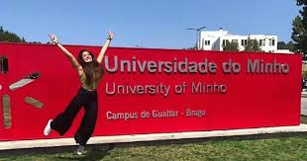
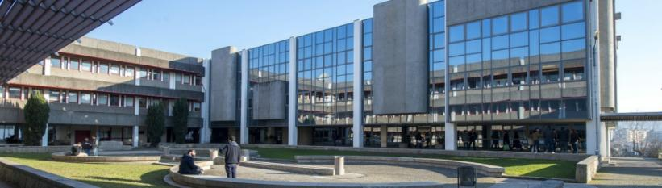
ATEE Winter Conference 2026, UMinho, Braga
We are looking forward to welcoming you!

